Slide 1

Quantum Optimal Control: Using GRAPE to Generate Optimal Pulses
Ben Rosand
IBM Quantum Intern
with
Thomas Alexander
Zachary Schoenfeld

Slide 2
Quantum Optimal Control
Quantum Optimal Control is the process of engineering a unitary evolution as close to a target unitary in a system. Specifically we use pulse controls to evolve the unitary of a transmon.

Slide 3
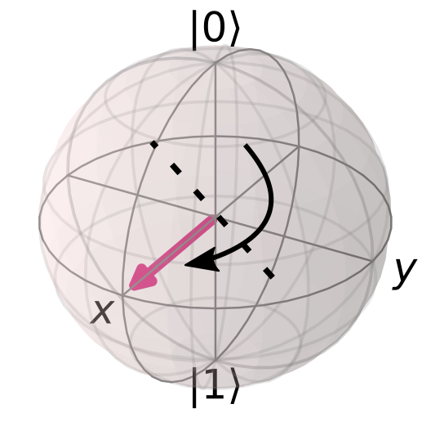
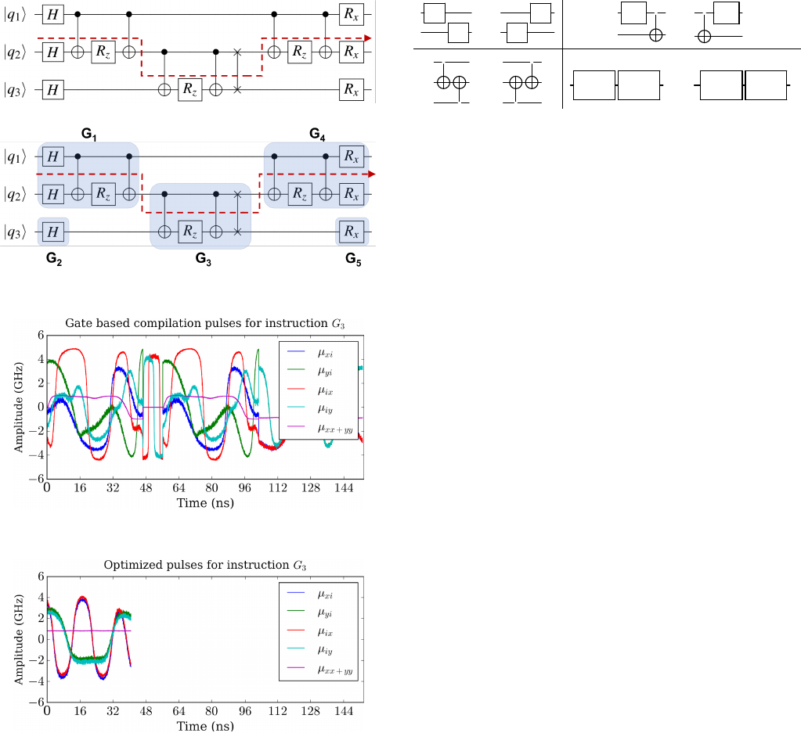


Problem
Less accurate circuits
Inefficient pulse sequences
$$≈$$
H
Pulses are calibrated for a specific set of basis
Calibrations optimize fidelities of basis gates, not circuit processes.
[1]
[3]
Slower and potentially less accurate qc programs
[2]
Notes:
Point out that graph is from Yunong’s paper also These calibrations are not optimal in the presence of error sources

Slide 4
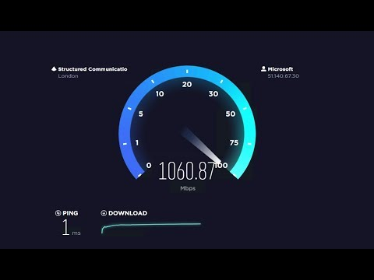

Solution
Unitary evolution-optimized pulse sequences
Gate aggregation
GRAPE (or other OCT)
Gradient ascent pulse engineering
$$≃$$
H
[3]
[1]
OPTIMIZED Quantum Programs
[4]
Notes:
Point out change in yunong paper

Slide 5
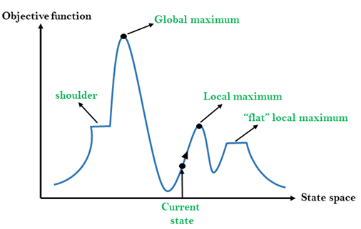

Gradient Ascent Pulse Engineering (GRAPE)
Initialize pulse guesses
Calculate density operator fidelity with given sequence
Move in direction of greatest increase in fidelity
$H\left(t\right)≈H\left(t_{k}\right)=H_{0}+\sum_{j=1}^{N}{u_{jk}}H_{j}$
$f_{PSU}= \frac{1}{d}\left|tr\{X_{targ}^{\text{†}}X(T)\}\right|$
[5]
Notes:
Mention that we are working with GRAPE with a state to state transfer as an objective function(fpsu). But in general we could use any OCT technique such as those presented by Sophia yesterday

Slide 6
Optimal Control Development in Qiskit
Convert IBM Chip hamiltonians to Qutip standards
Run QuTiP GRAPE algorithm
Run the output pulses through IBM simulators and devices
Perform Quantum Process Tomography (QPT) to characterize and evaluate gates

Slide 7

Qiskit – QuTiP – Qiskit
[6]
IBM Hamiltonian format differs from Qutip
Conversion and unit conversion necessary
Extensive Qutip API investigation
Ultimately one of the biggest unexpected challenges of this project

Slide 8
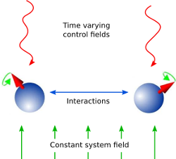

QuTiP Grape
Models Unitary evolution
Control field parameters + system field
Goal: maximize fidelity $f_{PSU}$
$f_{PSU}= \frac{1}{d}\left|tr\{X_{targ}^{\text{†}}X(T)\}\right|$
[7]

Slide 9
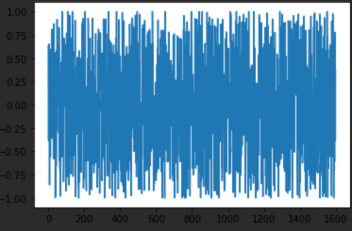


Real device testing
X gates
H gates
GRAPE $π$ pulse: 90.2%
Default $π$ pulse: 92.6%
4096 shots
Is this bad – No
GRAPE Hamiltonian:
$$H=\frac{ω\left(1−σ_{z}\right)}{2}+Ω_{d0}σ_{x}$$
GRAPE
$π$ Pulse
Schedule
Notes:
speedup of 1.5x for x gate in Yunong paper, also note that with a more physical model better results – highlight this, important to have most accurate physical model

Slide 10
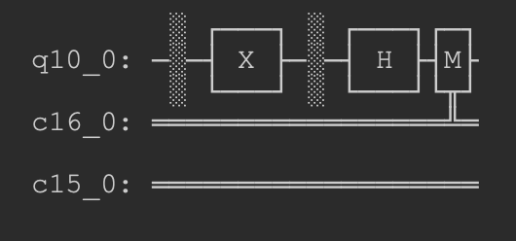
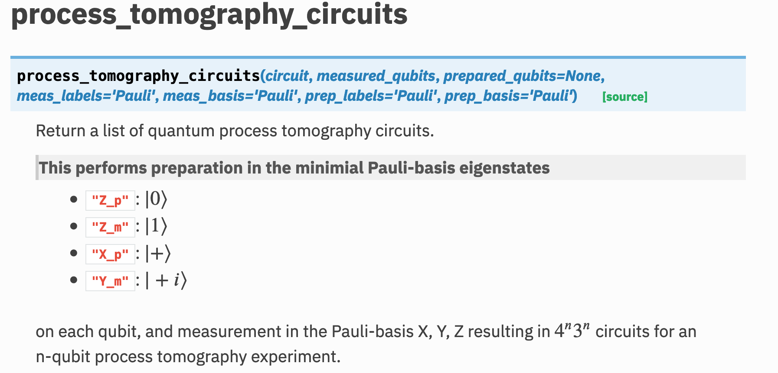
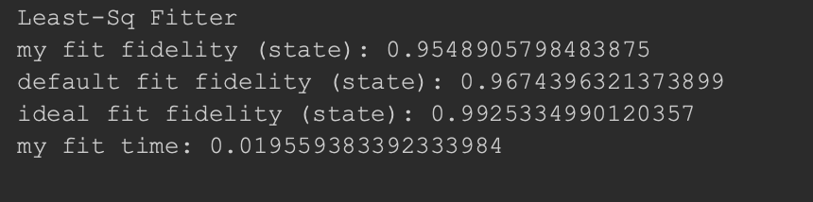
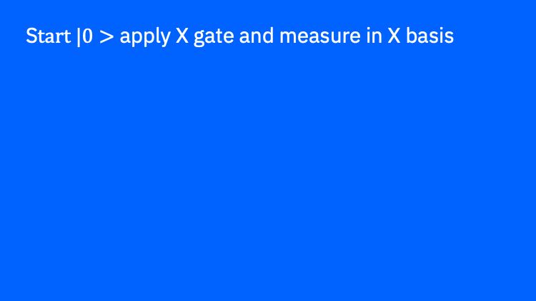
Quantum Process Tomography
S$tart |0>$ apply X gate and measure in X basis
Test response on every permutation of start basis and measurement basis
GRAPE X gate fidelity (missing process see git)
[8]
Notes:
missing process fidelity because of github but feeling confident
-- ideal is with qasm, less noise then pulseAer?
compared to unitary which is run on unitary simulator 0 noise

Slide 11
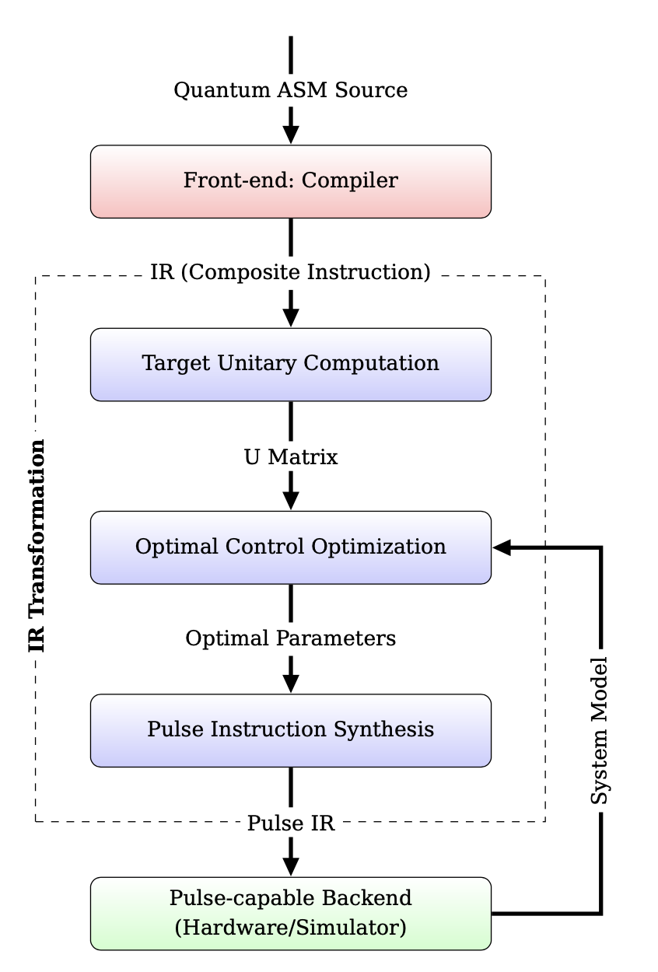
XACC QOC pipeline [9]
XACC example pipeline

Slide 12
Qiskit Pulse Pipeline
Quantum Logic Gates
Gates transpiled to basis gates
Basis gates compiled to pulses
Pulses run on hardware

Slide 13

Qiskit Pulse Pipeline
Quantum Logic Gates
Gates transpiled to basis gates
Basis gates compiled to pulses
Pulses run on hardware

Slide 14
Potential Qiskit Pulse Pipeline
Quantum Logic Gates
Gates transpiled to basis gates
Basis gates compiled to pulses, with some gates compiled to GRAPE pulses
Pulses run on hardware
Notes:
We will need a way to estimate the system Hamiltonian for this compilation as well

Slide 15
Next Steps
Package and submit PR for single qubit QOC
Add in gate aggregation
Extend to multiple qubits
Create wrapper for qutip and qiskit hamiltonians

Slide 17
Citations
[1] Loading gif: https://gifer.com/en/LE57
[2] Bloch Sphere: https://qiskit.org/textbook/ch-states/single-qubit-gates.html
[3] Pulse graph: https://arxiv.org/pdf/1902.01474.pdf
[4] Fast speedtest: https://www.youtube.com/watch?v=xt0EOY0GcuI
[5] Hill climbing: https://www.geeksforgeeks.org/introduction-hill-climbing-artificial-intelligence/
[6] Qutip banner: qutip.org
[7] Grape image: http://qutip.org/docs/latest/guide/guide-control.html
[8] Qiskit docs: https://qiskit.org/documentation/stubs/qiskit.ignis.verification.process_tomography_circuits.html
[9] XACC pipeline: https://arxiv.org/pdf/2006.02837.pdf

Slide 18
Shi gate aggregation speedup [3]

